Slide 1


FLOWER SPECIES RECOGNITION
GUIDE
D.VENAKATA REDDY, M.TECH.,(Ph.D)
Asst. Prof
Presented By
M. Tirumala Vamsi (19471A05M7)
K. Pavan Kumar (20471A0520)
J. Sai Manikanta Harshith (19471A05M1) DB-3

Slide 2
contents
Abstract
Literature Survey
Proposed Method
Design
Outputs
Conclusion

Slide 3
abstract
Flower species recognition is a challenging task due to the large variability in flower appearance and the fact that many species look similar.
Identifying each of them requires a botanist with immense knowledge and skills.
Identifying the scientific names and family of the flower species is complicated too.
In this rising era of technologies most of the impossible are made possible by incorporating artificial intelligence into real world problems.
By introducing machine learning algorithms such as convolutional neural networks for identifying flower species with just an image would be a great help for industries like pharmaceuticals and cosmetics. Convolutional neural networks can efficiently identify a flower by just feeding an image of the flower to be recognized.
In this system taking an image in your mobile camera, uploading it and just clicking the predict button is all that is needed to know more about a beautiful flower that you have just seen.

Slide 4
LITERATURE survey
Authors | Dataset | Details
Steven Puttemans et al | Dataset of Orchid flowers | They have used SVM For orchid flower detection.
Yuanyuan Liu et al | 79 categories of flowers and Oxford 102 dataset | They have used Cnn for 79 categories dataset they got 76.54% of accuracy and for Oxford 102 dataset they got 84.02% of accuracy.
Shantala Giraddi et al | 5 categories of flowers | They have used CNN and got 97.67% validation accuracy and testing accuracy of 95%.
Mengxiao Tian et al | Oxford university Dataset | Accuracy of 83.64% based on evaluation standard of Pascal VOC2007 and 87.4% based on evaluation standard of Pascal VOC2012.
Saiful Islam et al | Dataset of 10 local flowers | They have used CNN and got 85% accuracy.
Isha Patel et al | 102 categories of flowers | They have used MKL and SVM and got 76.92% accuracy.

Slide 5
proposed method
The workflow of our project starts by acquisition of images.
We split the dataset into training and testing images.
Images Augmentation is the next step of our process.
We have built the model using the dataset.
We have evaluated the model for its accuracy.

Slide 6
design
design
Preprocessing
i)Normalization
ii)Data Augmentation
Creation of Deep learning Model
Training the model
We have trained the model for 25 epochs.
INCEPTION RESNET V2
Flatten Layer
Two Dense Layers

Slide 7
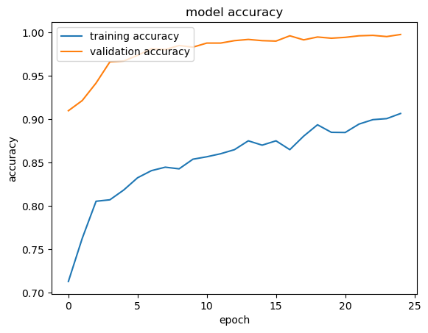
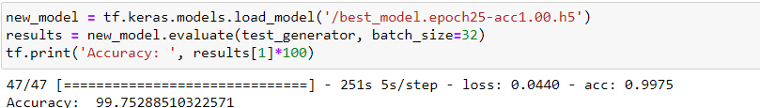
DESIGN
Saved the best model based on accuracy and loss.
We have got a validation accuracy of 99.76 and testing accuracy of 99.75.

Slide 8
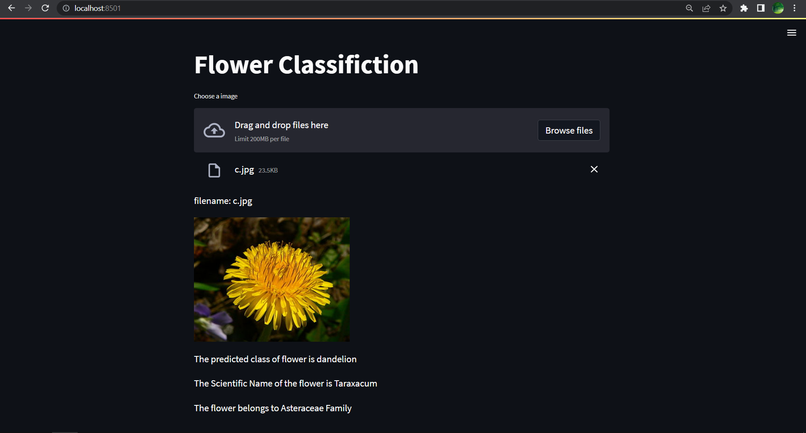
Results

Slide 9
Conclusion and future scope
We are able to classify the different types of flower with good accuracy using transfer learning.
We can apply the same project to a large dataset of flowers and identify various kinds of flowers easily with out requiring specialist in the field.

Slide 10

Thank you

